Slide 1

Name: --------------- Student ID: -------------- Subject:------------------
Presentation Topic: Online Books store

Slide 2
Introduction
An online bookstore built with PHP is a web application that allows users to browse, search, and purchase books online. It provides a convenient and accessible platform for book lovers to discover new titles, read reviews, and make purchases from the comfort of their own homes.
Advantages of Online Bookstores
Online bookstores offer several significant advantages over traditional brick-and-mortar bookstores:
Convenience and Accessibility
24/7 Access: Customers can shop anytime, anywhere, without being limited by store hours.
Wide Selection: Online bookstores offer a vast array of titles, including rare or out-of-print books that may not be available locally.
Easy Search: Customers can quickly find books by author, title, genre, or subject matter using search functions.

Slide 3

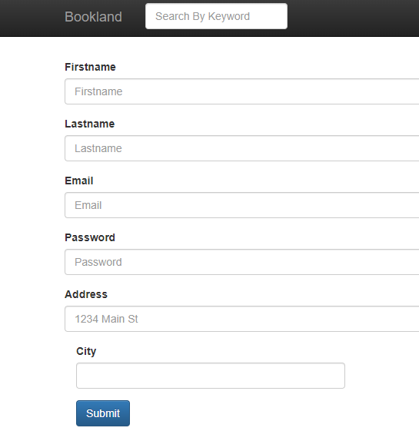
Project Over View
Key Features:
User registration and login
Book search and browsing
Shopping cart and checkout
Order history and tracking
Book reviews and ratings

Slide 4
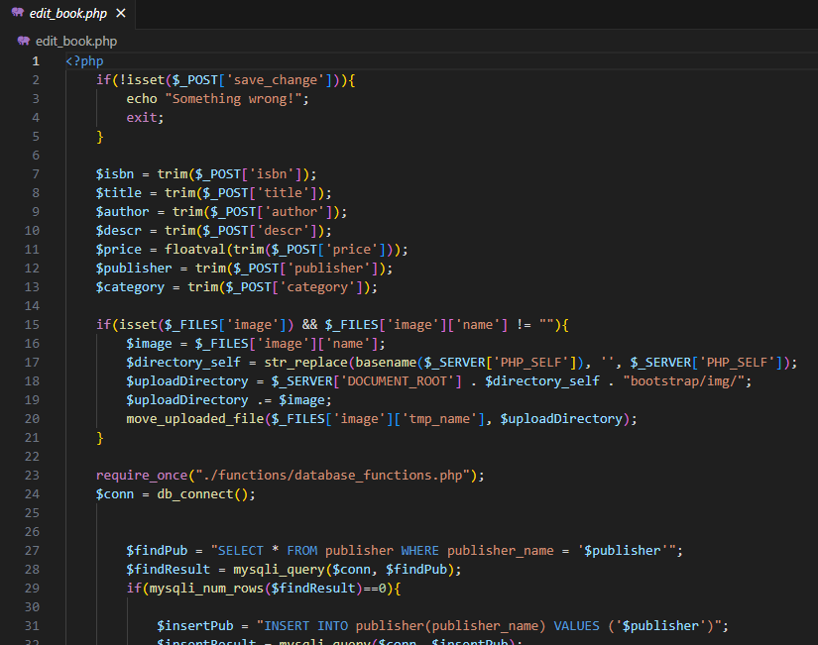
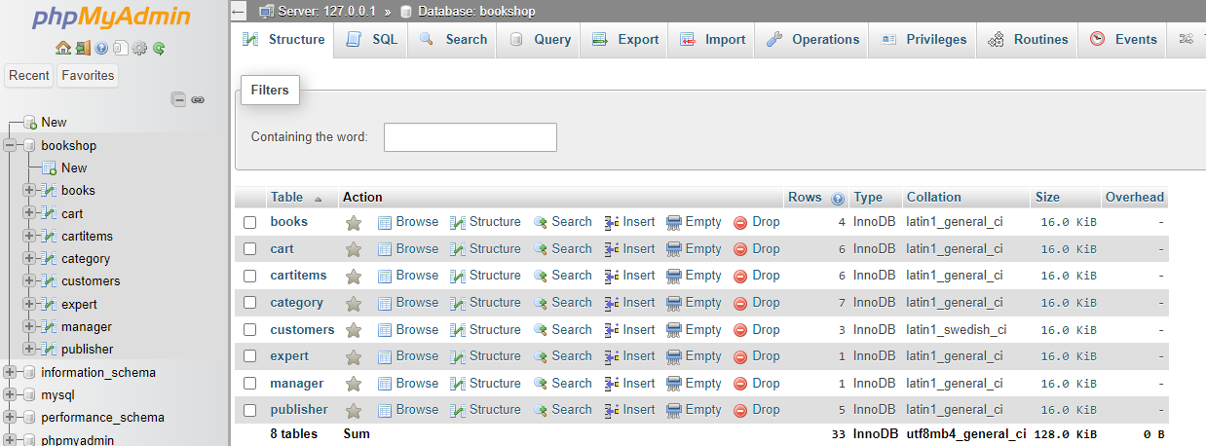
Technology Stack
PHP programming language Web Database ( MySQL)
Frontend technologies (HTML, CSS, JavaScript)

Slide 5
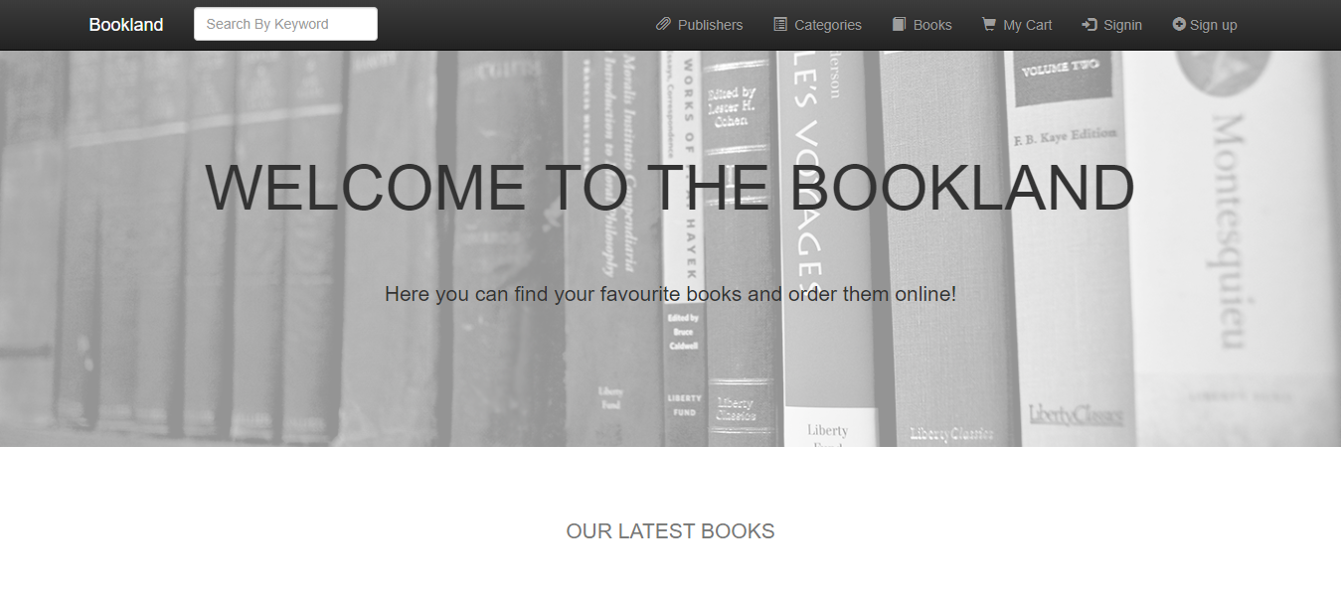
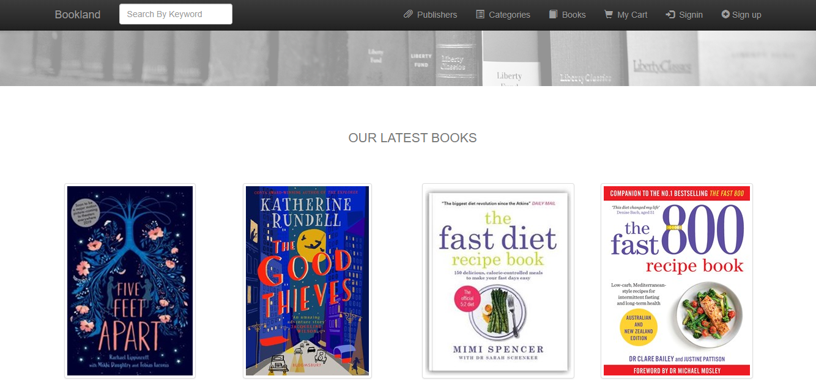
User Interface Design
Home page

Slide 6
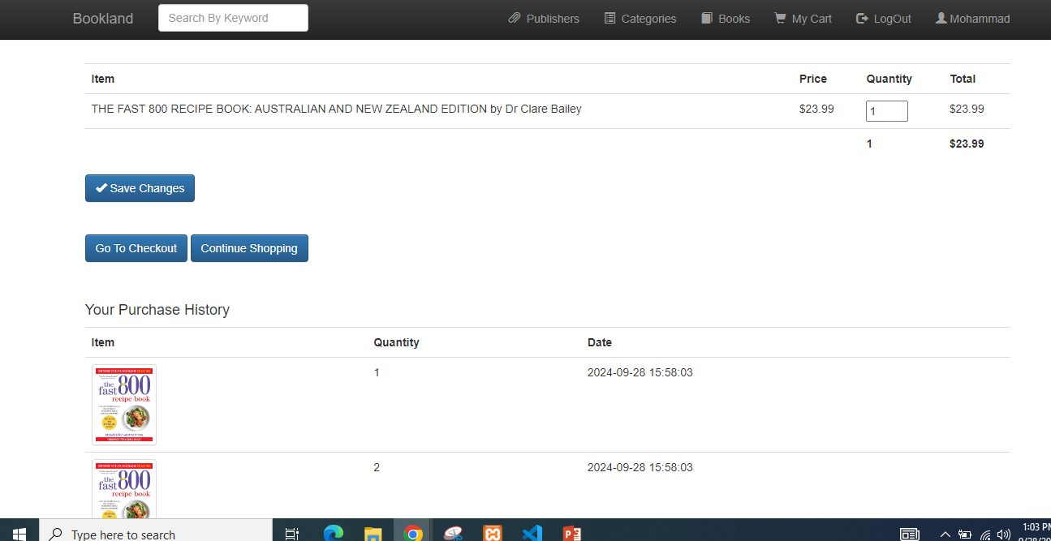
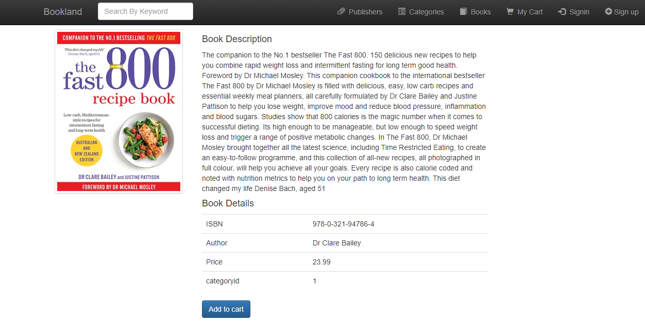
User Interface Design
Book Details:

Slide 7
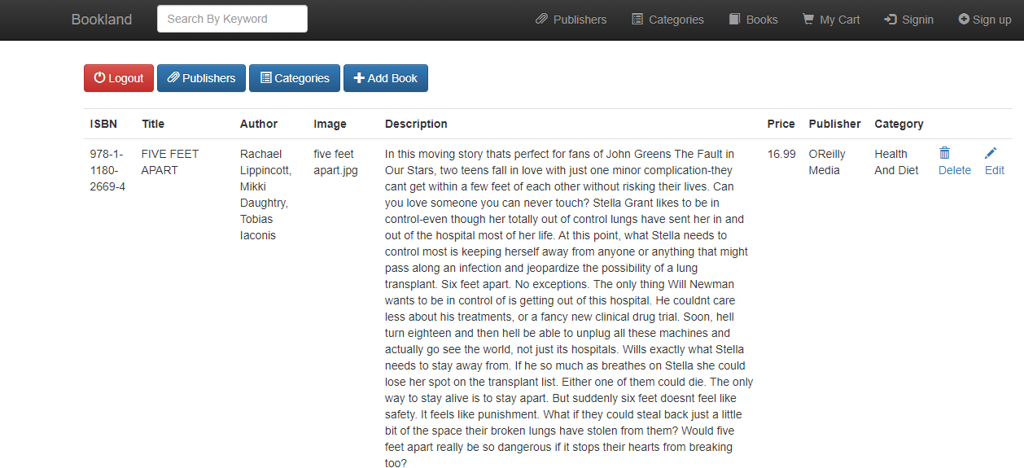
Admin Interface Design
Admin Details:

Slide 8
Technology Stack
PHP: Discuss the role of PHP in building the backend logic and interacting with the database.
Database: Describe the database structure and how it is used to store book data, user information, and orders.
Frontend Technologies: Discuss the use of HTML, CSS, and JavaScript for creating the user interface.

Slide 9
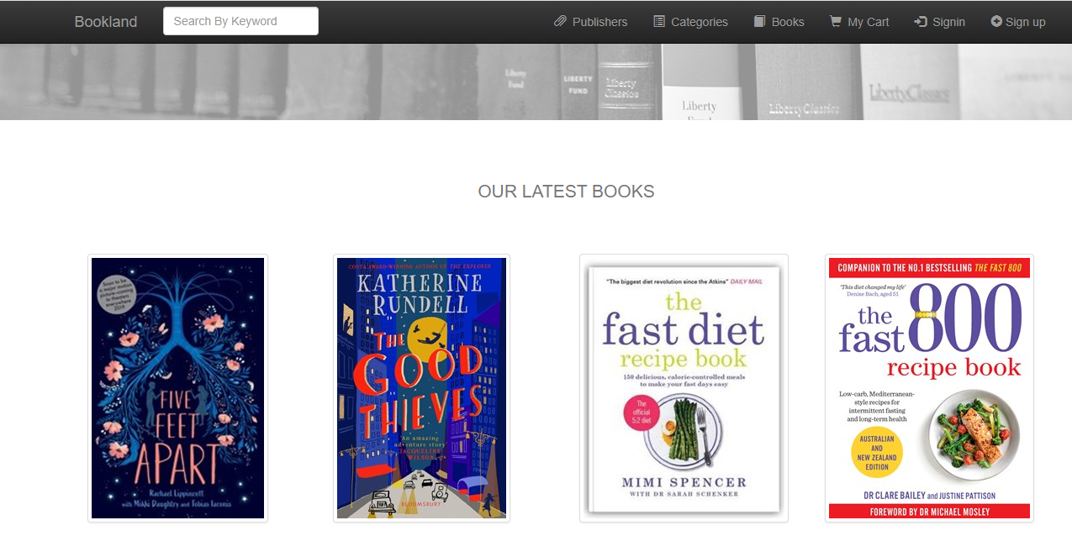
Purpose of an online book store
Expanding Access: Online bookstores make books available to a wider audience, including those in remote areas or with limited access to physical bookstores.
Offering a Vast Selection: Online bookstores can offer a much larger selection of books than traditional bookstores, including rare, out-of-print, and international titles.

Slide 10
Cost-Effectiveness
Competitive Pricing: Online bookstores often offer lower prices than traditional bookstores due to reduced overhead costs.
Discounts and Deals: Customers can benefit from frequent sales, promotions, and coupon codes.
Free Shipping: Many online bookstores offer free shipping on eligible orders, further reducing costs.

Slide 11
Benefits Online Books Store
Cost-Effective:
Competitive Pricing: Often offer lower prices than traditional bookstores.
Discounts and Deals: Benefit from frequent sales, promotions, and coupons..
Personalized Experience
Recommendations: Receive personalized book suggestions based on your reading history.
Reviews and Ratings: Read reviews from other customers to make informed choices.
Wishlists: Create and share wishlists with friends and family.

Slide 12
Benefits Online Books Store
Time-Saving:
No need to travel: Avoid the hassle of going to a physical store.
Quick checkout: Complete your purchase in a few clicks.
Instant gratification: Receive your books quickly through efficient shipping.
Eco-Friendly:
Reduced carbon footprint: Contribute to environmental sustainability by reducing the need for physical stores and transportation.
Digital options: Choose digital formats (e-books, audiobooks) to eliminate physical waste.

Slide 13

Thank you

